Slide 1
Logistics: Project
Milestone 1 reports are returned
Let me know if you want to discuss
Milestone 2: Due Nov 20 (Friday)
Midterm Project Pitch and Discussion: Nov 19 (Thu) in Lecture
A chance to get feedback or collect data from other students
Think about whether/how you can best utilize this time

Slide 2
Peer Review
Again, remember to submit your peer review form

Slide 3
Lecture 15 AI-Assisted Workflow Design
Instructor: Chien-Ju (CJ) Ho

Slide 4
Workflow
Dictionary definition
“the sequence of steps involved in moving from the beginning to the end of a working process”
Enable crowdsourcing to solve complex tasks
TurKit: A programming framework to “code” the workflow
Crowdforge: A general workflow pattern
Turkomatic: Incorporating humans in the workflow design

Slide 5
Again, think about this example

Slide 6
Designing Workflows
Some workers are asked to perform improvement tasks
Some workers are asked to vote on whether the improvement is good
Little et al. “TurKit: Tools for Iterative Tasks on Mechanical Turk”. HCOMP 2009

Slide 7
Designing Workflows
Version 6
Little et al. “TurKit: Tools for Iterative Tasks on Mechanical Turk”. HCOMP 2009

Slide 8
Other Workflows
Calculate nutrition values of a photo [Noronha et al. UIST 2011]
Proofreading and document editing [Bernstein et al. UIST 2010]
Extracting steps from how-to videos [Kim et al. CHI 2014]
Tag – Identify - Measure
Find – Fix - Verify
Find – Verify – Expand

Slide 9
Workflow design is domain specific and requires a great amount of human effort.
Can we utilize AI to help design workflows…

Slide 10
AI-Assisted Workflow Design
(utilizing AI to help tune the parameters of workflow)
Decision-theoretic Control of Crowd-sourced Workflows.
Peng Dai, Christopher H. Lin, Mausam, Daniel S. Weld. AI Journal 2013.

Slide 11
Example
Decisions to make at each step
Should we keep voting?
Should we create an improvement task?
Should we terminate the process and output the results?
This is a sequential decision-making problem under uncertainty.

Slide 12
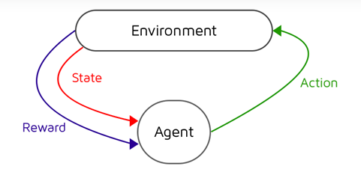
Markov Decision Process
Markov decision process (MDP)
Partial observable Markov decision process (POMDP)
State is not directly observable,
We can observe some output/signals depending on the state
(think about problem 2 of assignment 3)
Require additional reasoning
Main components
States (of the environment)
Action
State transitions
Rewards

Slide 13
TurKontrol
POMDP formulation
Actions = {vote, improve, terminate}
State = {(q, q’)} (q: the original quality of the article, q’ the improved one)
State transition, observation, rewards are defined w.r.t. to the inference

Slide 14
Improvements over Fixed Parameters

Slide 15
Discussion (If time permits)
In computer science theory, we often analyze the performance of algorithms using space and time complexity.
In human computation algorithms, in which humans respond to function calls, what factors do you think are the important things to consider if we want to develop new theories to characterize the performance of this type of algorithms?
Are there other aspects of workflow design we can utilize AI to help? How?

